Slide 1

Facial Emotion Recognition System for Multifaceted Applications
Team 5
Navaneeth Kumar
Eslin Kiran
Ramya M
Sindhuja
Venkata Mani Kiran Kumar

Slide 2
Introduction
Welcome to our presentation! In our digital world, understanding human emotions is crucial for creating engaging experiences. Our project introduces a real-time facial emotion detection application, leveraging advanced technology to analyze facial expressions captured by a webcam instantly. Through this presentation, we'll explore how our application recognizes emotions like happiness, sadness, anger, surprise, disgust, and fear. From improving education to enhancing healthcare, our project showcases the transformative potential of facial emotion recognition technology in various fields. Join us as we dive into the exciting world of Emotion-aware computing.

Slide 3
Project Overview
Our project focuses on developing a user-friendly application that detects emotions in real time using a webcam. It employs advanced computer vision and deep learning techniques to analyze facial expressions and accurately recognize emotions like happiness, sadness, anger, surprise, disgust, and fear.
Key Features:
Facial Emotion Analysis: The application analyzes facial expressions captured through a webcam instantly.
Deep Learning Models: We use advanced deep learning models to train the system to recognize a wide range of emotions accurately.
User-Friendly Interface: The application offers an intuitive interface for easy interaction and viewing of detected emotions.

Slide 4
Objectives
Real-time Emotion Detection:
Implement a real-time video processing system using computer vision for face detection.
Utilize a pre-trained deep-learning model for facial emotion recognition.
Graphical User Interface (GUI):
Develop an intuitive GUI using Tkinter to facilitate user interaction.
Allow users to upload images or capture real-time video for emotion prediction.
Model Evaluation and Optimization:
Evaluate the pre-trained emotion recognition model's performance using relevant metrics.
Explore model optimization techniques for efficient real-time processing.
Integration of Facial Landmarks:
Implement facial landmarks extraction using the "dlib" library to enhance emotion detection accuracy.

Slide 5
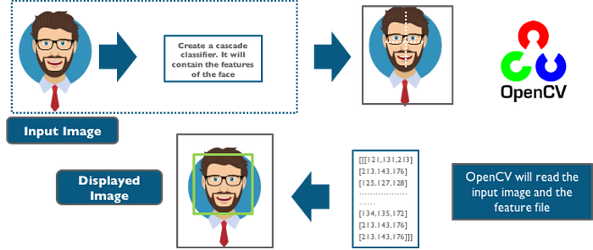
Feature Extraction and Face Localization

Slide 6
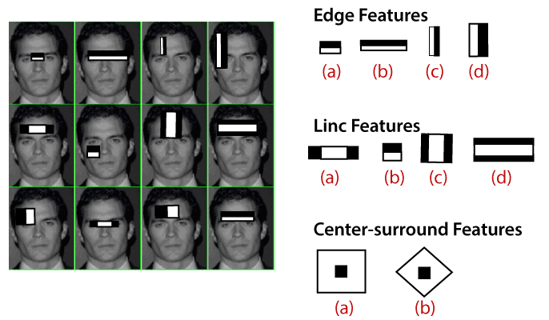
We extract the features from the image, with the help of edge detection, line detection, and centre detection. Then provide the coordinate of x, y, w, h, which makes a rectangle box in the picture to show the location of the face. It can make a rectangle box in the desired area where it detects the face.
Face recognition is achieved by calculating the Euclidean distance between the feature vectors of a probe and reference image. This method is effective in illumination change by its nature, but it has a considerable drawback.

Slide 7
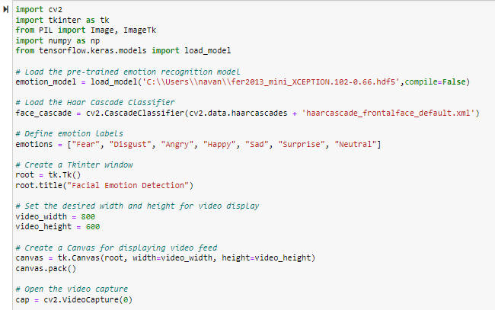
Working Model

Slide 8
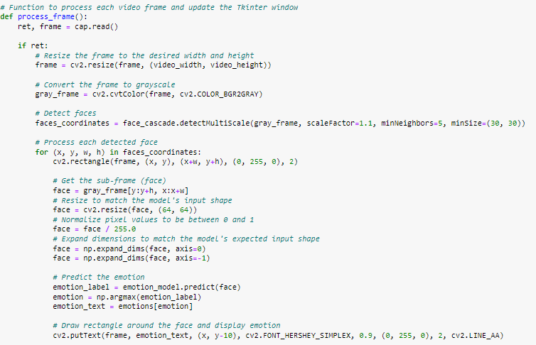

Slide 9
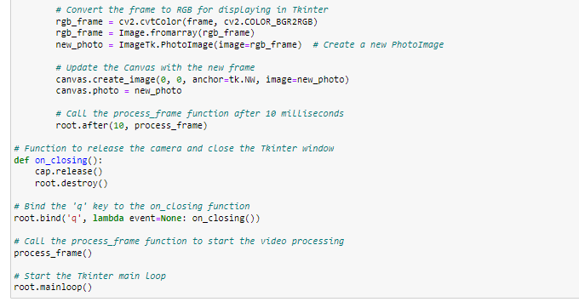

Slide 10
Scenarios
Security Measures: Emotion recognition is actively contributing to enhanced security measures in schools and institutions. By analyzing facial expressions, it aids in preventing violence and improving overall security, ensuring safer environments.
HR Assistance: Companies leverage AI with emotion recognition API capabilities as HR assistants. The system evaluates candidates' honesty and interest in positions by analyzing intonations, facial expressions, and keywords. Human recruiters receive comprehensive reports for final assessments, streamlining the hiring process.
Customer Service: Modern customer service centers employ emotion recognition systems equipped with cameras and artificial intelligence. These systems compare customers' emotions before and after service interactions, gauging satisfaction levels. In cases of dissatisfaction, the system prompts employees to enhance service quality, ensuring improved customer experiences.

Slide 11
Support for Differently Abled Children: Innovative projects, such as the one using Google Glass smart glasses, aim to assist autistic children in interpreting the emotions of people around them. By providing visual and auditory clues during interactions, the system helps differently abled children navigate social scenarios with greater understanding.
Audience Engagement: Companies utilize emotion recognition to gauge the audience's emotional responses, providing insights into business outcomes. Technologies like Apple's Animoji, which mimics facial expressions in emojis, display how emotion recognition is integrated into consumer products for enhanced engagement and user experience.
Video Game Testing: Facial emotion recognition is instrumental in video game testing, allowing companies to understand users' real-time emotions. This feedback informs the development process, ensuring that the final product aligns with user preferences and delivers a compelling gaming experience.

Slide 12
Healthcare: The healthcare industry embraces facial emotion recognition to optimize patient care. From identifying patients in need of immediate attention to prioritizing physician visits, emotion recognition technologies contribute to efficient healthcare management. Physicians can make informed decisions based on patients' emotional states, improving overall healthcare delivery.
These real-world scenarios demonstrate the versatility and impactful applications of facial emotion recognition across diverse sectors, from enhancing security to revolutionizing healthcare practices. As technology continues to advance, the integration of emotion recognition is likely to further enrich these applications, providing valuable insights and improving various aspects of human interaction

Slide 13
Technologies and Tools
OpenCV (cv2): OpenCV is used for computer vision tasks such as face detection and video processing.
Tkinter: Tkinter is used for creating the graphical user interface (GUI) for the application.
PIL (Python Imaging Library): PIL is used for image processing tasks, particularly for loading and manipulating images.
NumPy: NumPy is used for numerical computations and array manipulation, particularly for processing image data.
TensorFlow (via Keras): TensorFlow is used for loading and using the pre-trained emotion recognition model. Keras is the high-level neural network API used for building and training deep learning models.
Haar Cascade Classifier: Haar Cascade Classifier is used for face detection. It's a machine learning-based approach used for object detection.

Slide 14
Conclusion
Successful Implementation: The project has successfully implemented a real-time facial emotion detection system using a combination of computer vision and deep learning techniques.
Accurate Emotion Recognition: By leveraging pre-trained deep learning models and facial landmark detection algorithms, the system can accurately recognize a wide range of emotions in real time, including happiness, sadness, anger, surprise, and more.
User-Friendly Interface: The graphical user interface developed using Tkinter provides an intuitive and accessible platform for users to interact with the application, making it suitable for a wide range of users.
Practical Applications: The project demonstrates the practical applications of facial emotion detection technology across various domains, including education, healthcare, retail, security, and entertainment, showcasing its versatility and potential impact.
Future Scope: While the current implementation achieves the primary objectives of the project, there is room for further refinement and optimization, such as improving accuracy, expanding the range of supported emotions, and integrating additional features for enhanced functionality. This opens up avenues for future research and development in the field of facial emotion detection.

